Slide 1
API
Ishaan Malik

Slide 2
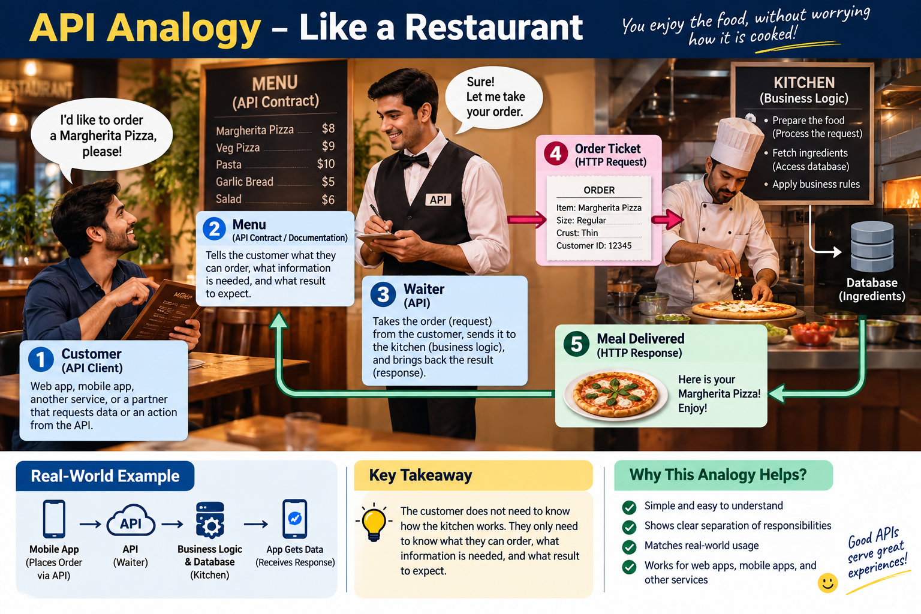

Slide 3
API = Application Programming Interface
An API stands for Application Programming Interface, which is a set of rules and protocols that lets different software applications communicate with each other.
In simple terms, it is a defined way for one software program to ask another software program for information (data) or tell it to do something (create, update or delete).

Slide 4
Advantages and Disadvantages
Advantages | Disadvantages
Connects completely different systems seamlessly (e.g., a phone app talking to a database). Automates manual tasks by letting computers update and sync data instantly. Saves development time by letting you plug into existing services (like Google Maps). Cuts costs by sharing resources across web, mobile, and desktop apps. | Completely reliant on internet connectivity to function. Requires ongoing maintenance as software and features change. Introduces security risks if the connection point is not heavily protected. Can become expensive if you rely heavily on paid third-party APIs.

Slide 5
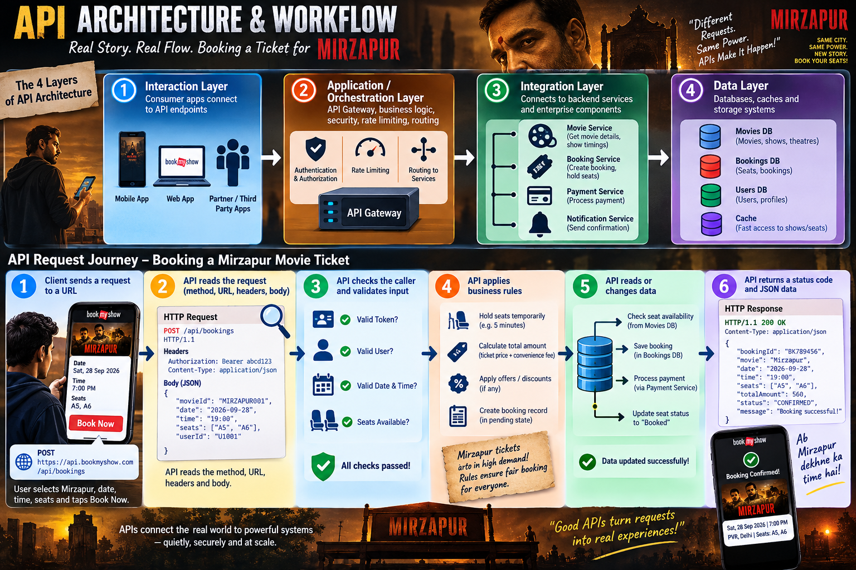

Slide 6
API Architecture
It is the structural blueprint and set of rules that defines how an API is designed, built, and operated.
It establishes how different software applications interact, what protocols they use, how data is formatted, and how security and performance are maintained across components.

Slide 7
4 Layers of API Architecture
Interaction Layer: The outward-facing boundary where consumer apps (web, mobile, third-party clients) connect to endpoints.
Application (or Orchestration) Layer: Houses the business logic, API gateways, routing mechanisms, and access control/rate-limiting protocols.
Integration Layer: Connects the API rules to internal backend microservices, functions, and enterprise components.
Data Layer: Manages underlying databases, caches, and storage systems to retrieve and save information securely.

Slide 8
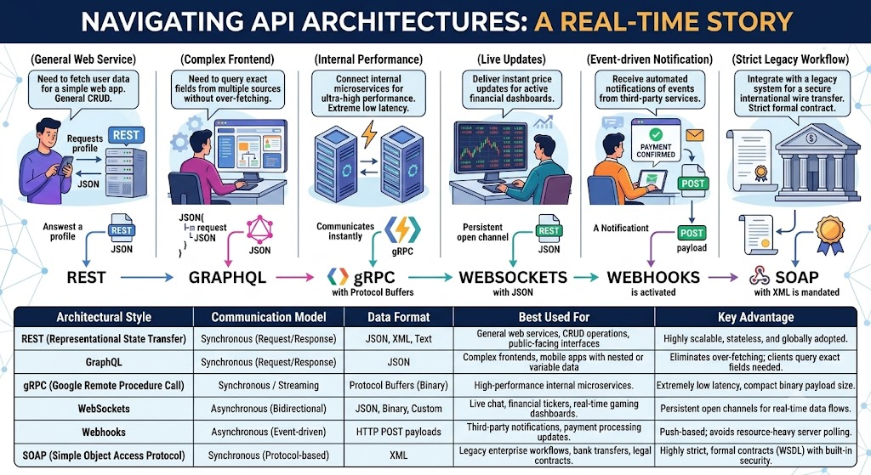

Slide 9
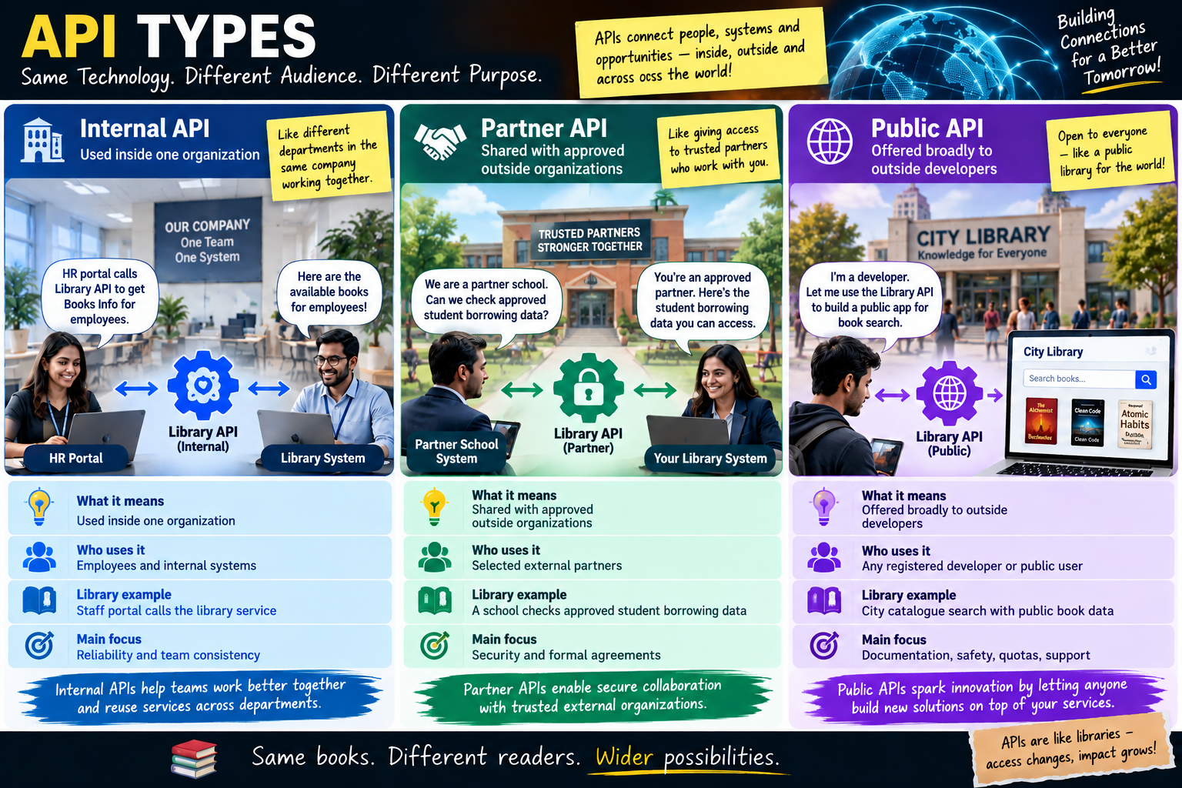

Slide 10
Quick Quiz
Which statement best describes an API contract?
A database backup file
An agreement describing how software communicates
A Docker image
A UI color guide
Answer: B

Slide 11
Quick Quiz
Who can be a consumer of an API?
Only browsers
Only mobile apps
Web apps, mobile apps, services and partners
Only SQL Server
Answer: C

Slide 12
Quick Quiz
Which API type is usually limited to approved external organizations?
A. Internal
B. Partner
C. Public
D. Localhost
Answer: B

Slide 13
API Pattern: Synchronous vs Asynchronous
Synchronous: ask and wait | Asynchronous: submit now, finish later
Synchronous | Asynchronous
The client makes a request and waits for the response. | The client sends a request, receives a quick acknowledgement, and real work completes later.
easy to understand; immediate result; easier to debug for beginners. | user is not blocked; handles longer workloads; reduces tight coupling.
Use when: The user needs an immediate answer. The operation is quick. The result is needed before the next step. | Use when: Work takes a long time. Many systems must be notified. The user does not need the final result instantly. A background process is safer or cheaper.

Slide 14
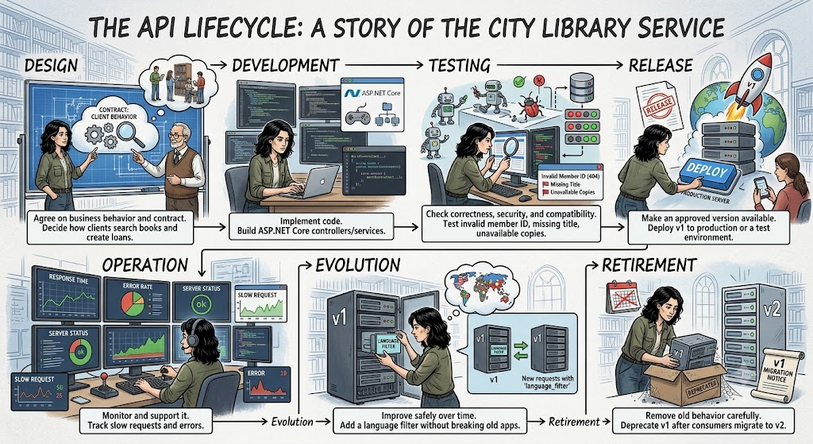

Slide 15
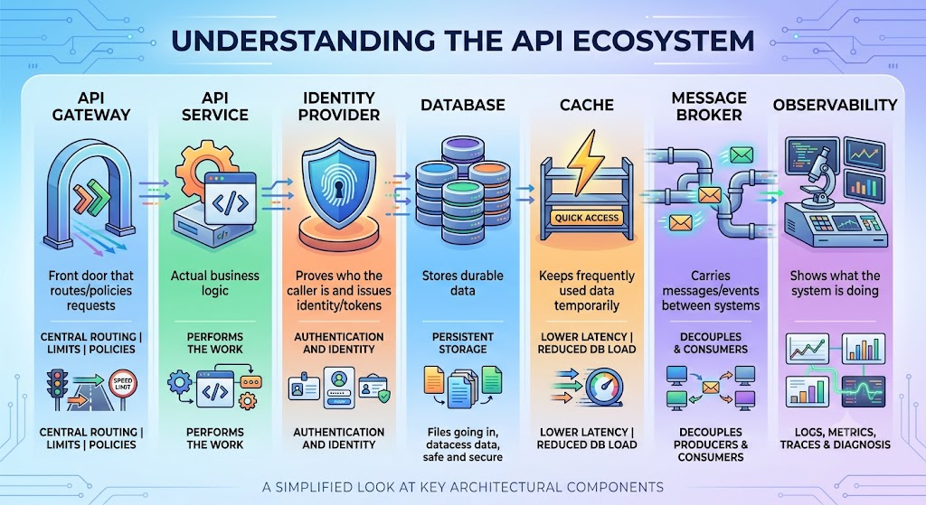

Slide 16
Quick Quiz
Which pattern is most natural for a long report that may take minutes?
Always synchronous
Asynchronous job pattern
Database direct access
GET only
Answer: B

Slide 17
Quick Quiz
In the restaurant analogy, the API is most like:
The kitchen floor
The waiter
The customer’s wallet
The restaurant building
Answer: B

Slide 18
The End
Q&A

